Slide 1

NON ISOLATED POWER CONVERTER FOR MICROGRIDS WITH IMPLEMENTATIONS OF IOT
EEE 4099
Guide - Nilanjan Tewari
Titash Banerjee - 19BEE1052
Chirantan Paul - 19BEE1079
Mujeeb Javed-19BEE1011

Slide 2
Objectives
Our project proposes a non-isolated DC-DC converter with high voltage gain at comparatively low duty ratio for renewable energy applications.
So it mainly proposes a different topology for high output voltage gain boost converters.
Usage of low duty ratio for high voltage gain requirement makes a considerable impact in reducing the conduction loss of the switch.
The single switch structure makes the converter attractive due to easy implementation of control algorithm during dynamic conditions.
The control algorithm will be implemented in a arduino microcontroller.
We will measure voltage and current across the output load, thus calculating the power across the given load, and this application will be displayed in a web based application using IoT.
All these topographies make this converter suitable for renewable energy sources like fuel cell, solar PV etc. with low output voltage.

Slide 3
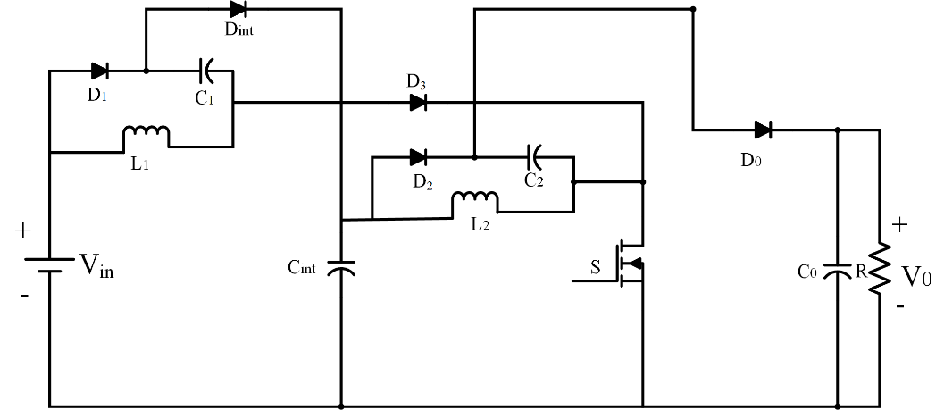
Circuit Diagram

Slide 4
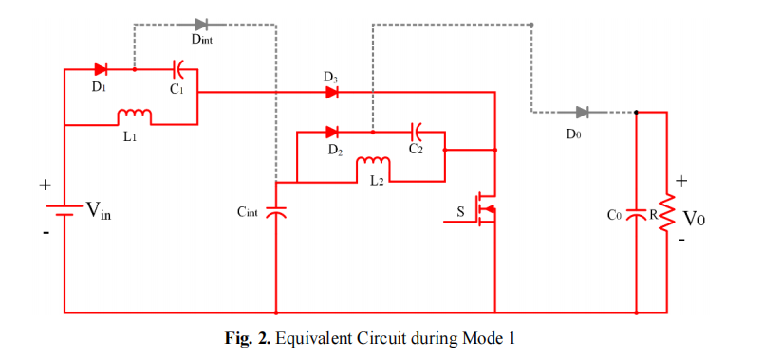
Mode 1

Slide 5
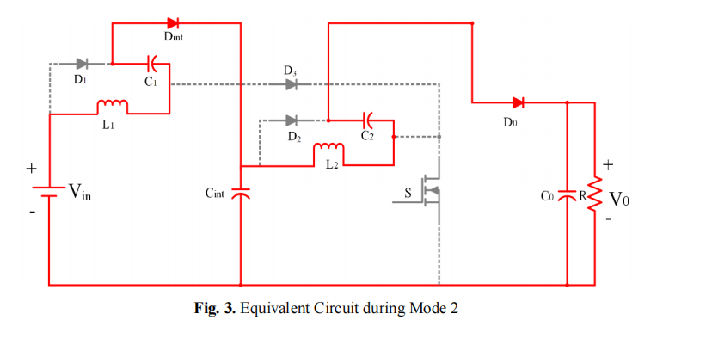
Mode 2

Slide 6
Circuit Design Specification
Parameters | Specifications
Output Power rating, P0 | 200 W
Output Voltage, V0 | 380 - 400 V
Input Voltage, Vin | 35 V
Switching Frequency, fSW | 50 kHz
Output Voltage ripple, ΔV0 | ± 5% of V0

Slide 7
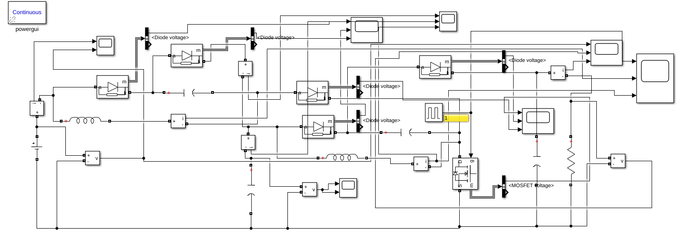
Simulink

Slide 8
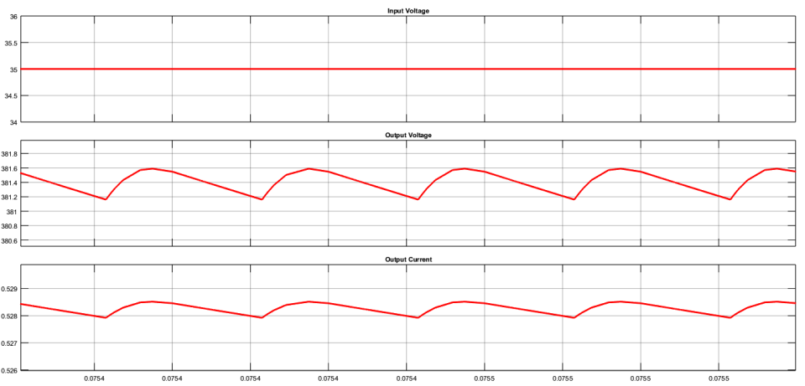
Simulation Results: Input Voltage, Output Voltage, Output Current

Slide 9
PCB Design Specification
Component | Component Number | Rating
 | Inductor
L1, L2 | PCV-2-274-10 | 280uH
 | Capacitor
C1,C2 | Custom | 10uF
Cint | Custom | 100uF
Co | Custom | 22uF
 | Diode(Power Schottky Diode)
Do.D1,D2,D3,Dint | MUR1540
 | Mosfet
Mosfet | IRFP4332PBF | Voltage across 600V
 | Voltage (Source)
V1 |  | 35V

Slide 10
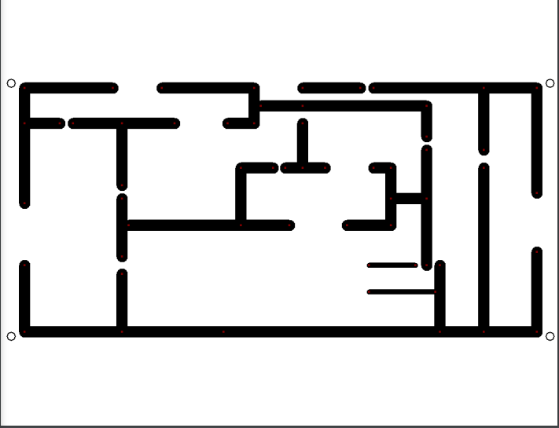
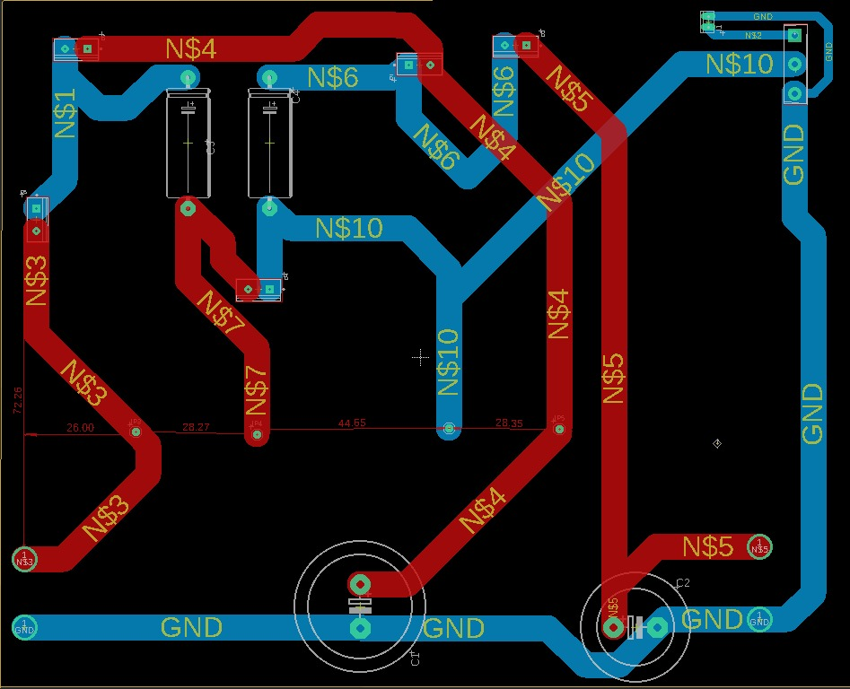
PCB Circuit Design
Double Layer PCB using Eagle Software
Single Layer PCB layout using Express PCB

Slide 11
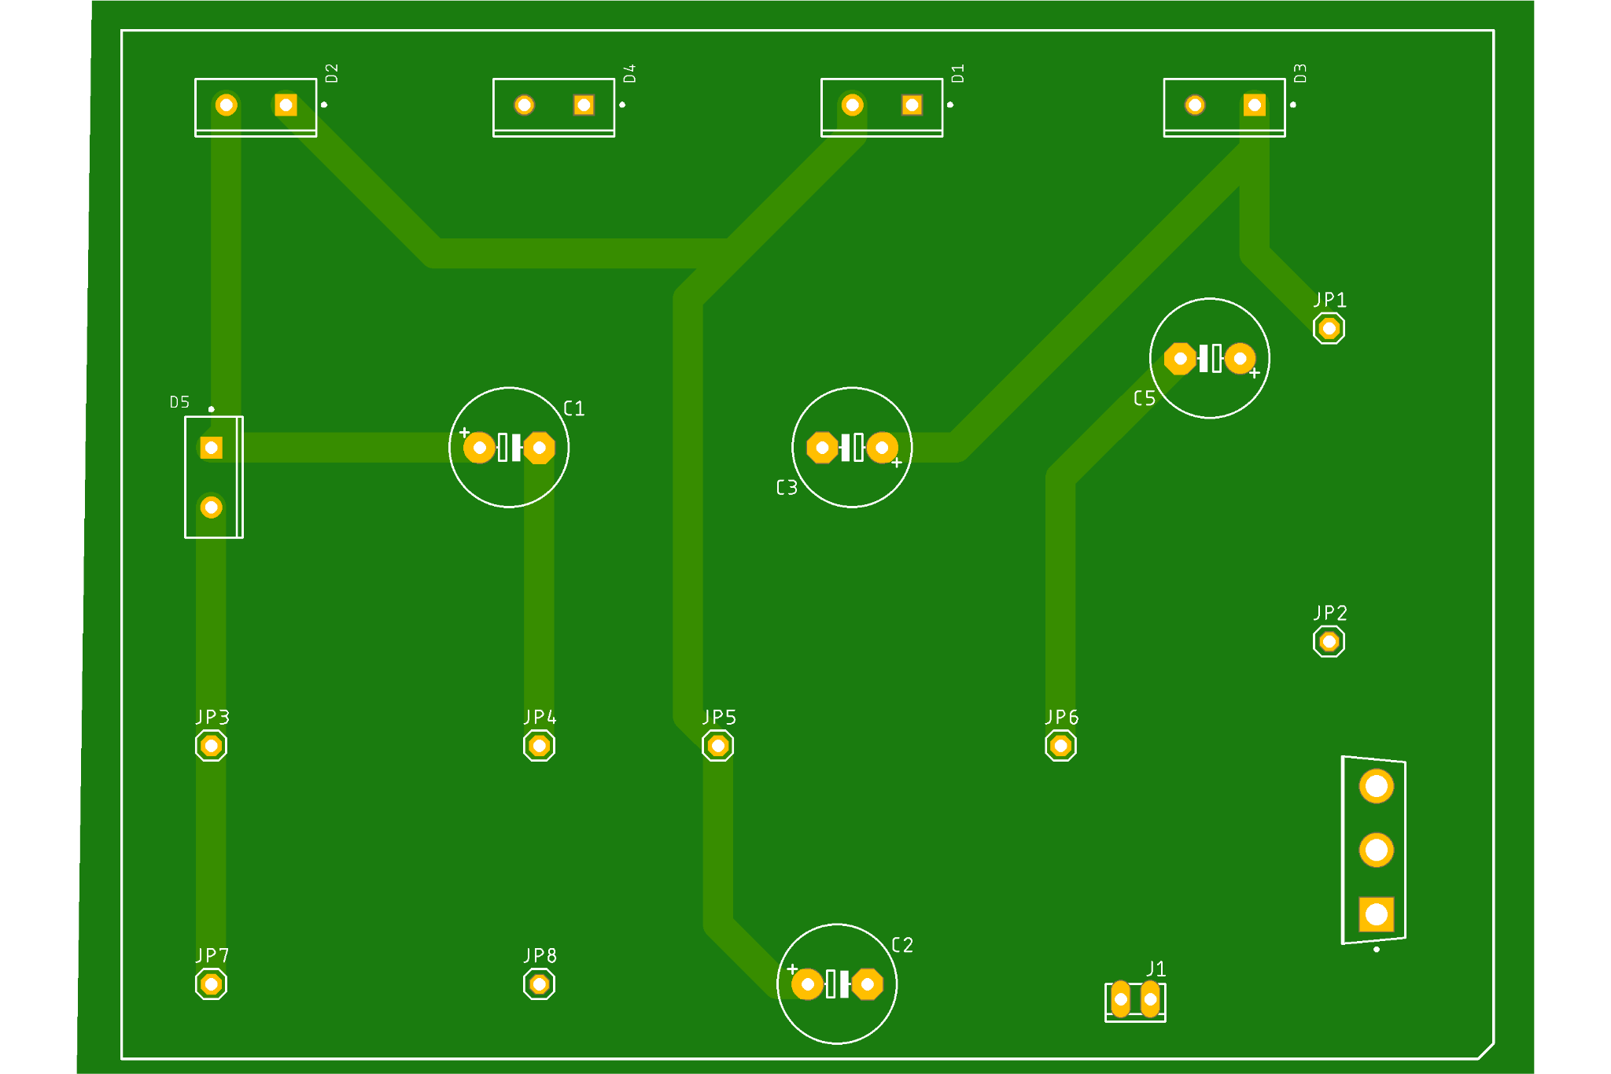
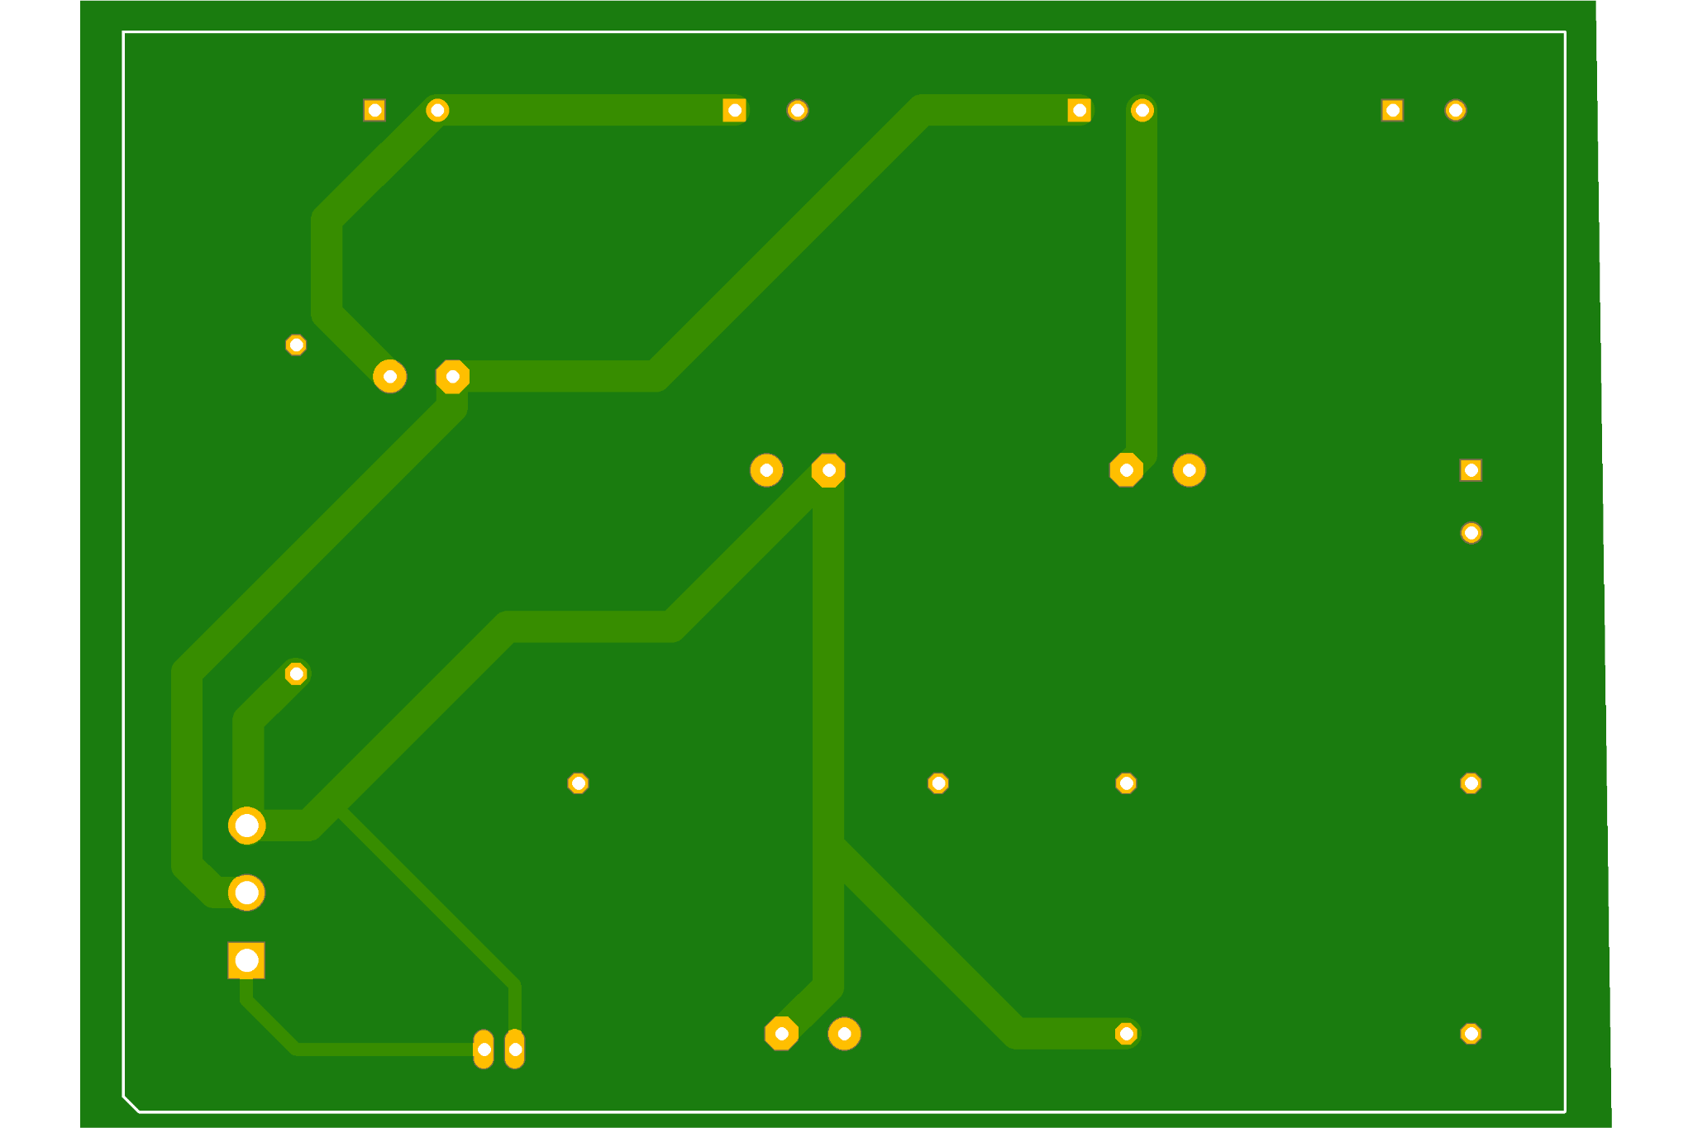
PCB TOP LAYER
PCB BOTTOM LAYER

Slide 12
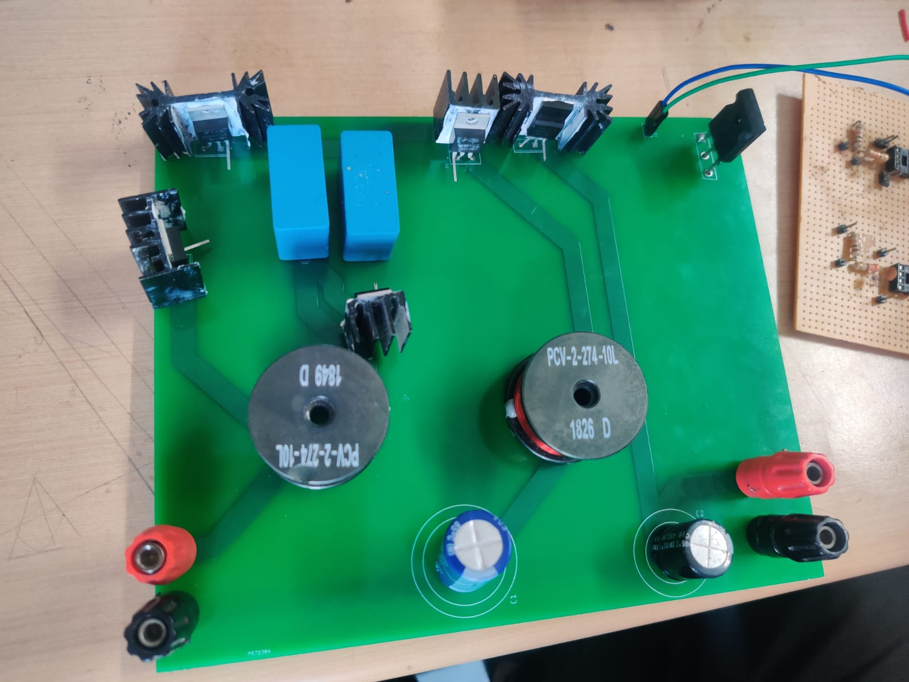
Hardware
Mosfet IRFP 4332PBF
Capacitor 10uF
Driver Circuit
Diode MUR 1545
Output Diode MUR 1660
Inductor 280uH
Output Terminal
Input Terminal
Capacitor 22uF
Double Layer PCB
Capacitor 100uF

Slide 13
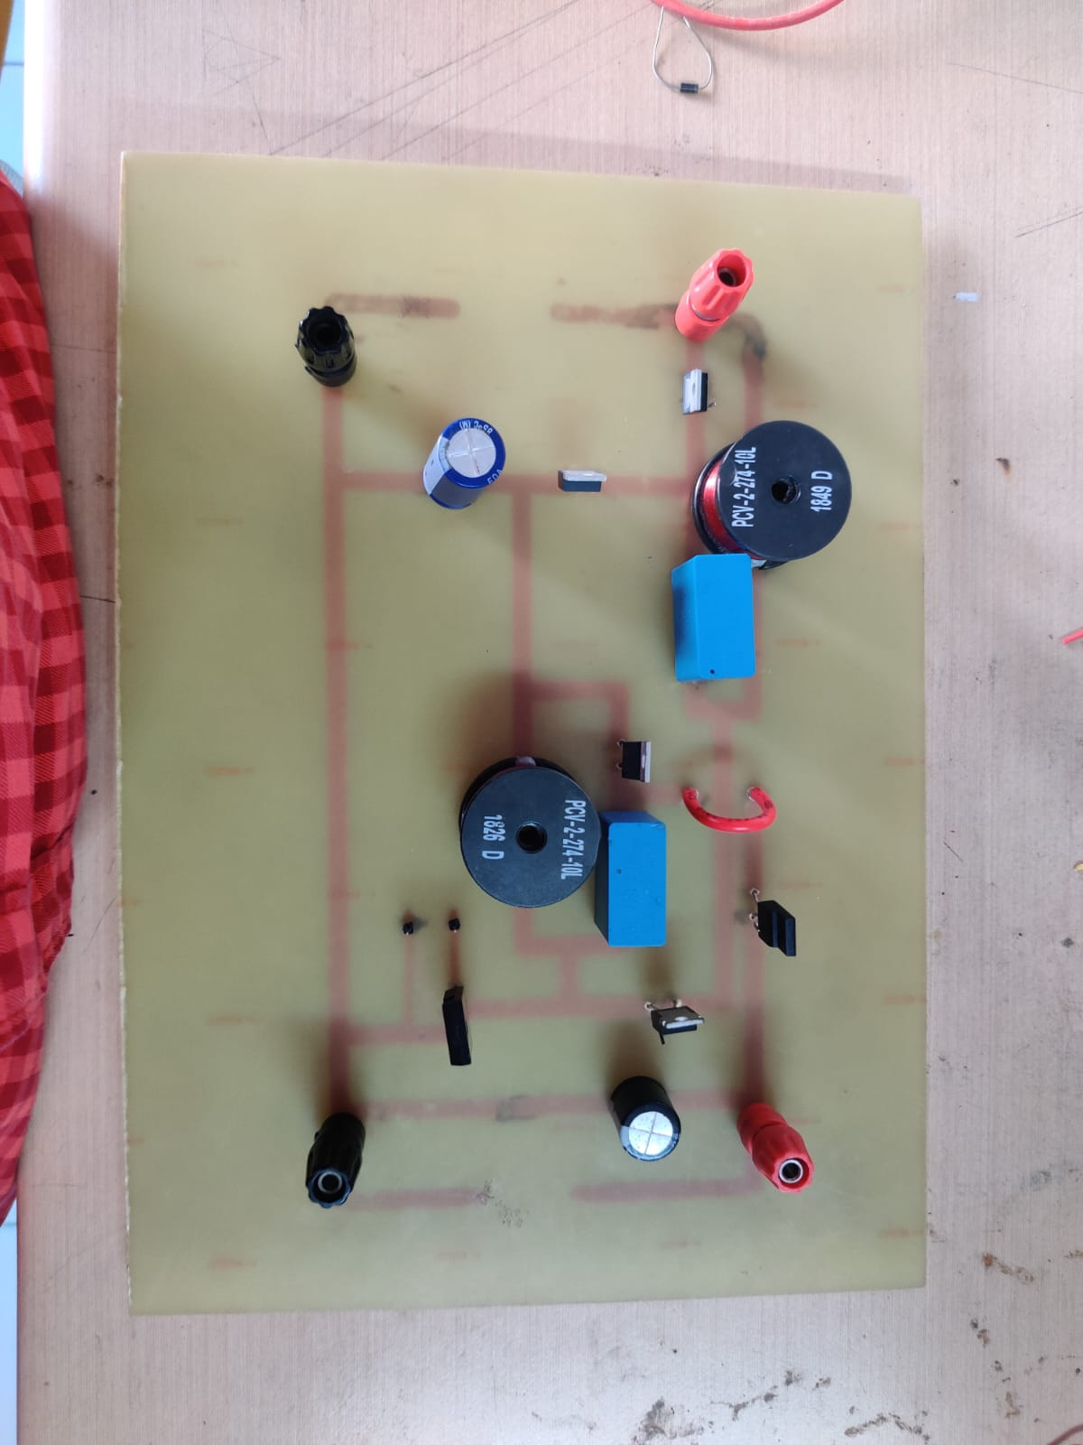
Capacitor 10uF
Inductor 280uH
Output Terminal
Input Terminal
Diode MUR 1545
Capacitor 22uF
Capacitor 100uF
Mosfet IRFP 4332PBF
Single Layer PCB

Slide 14
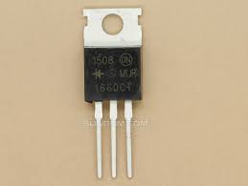
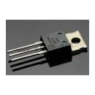
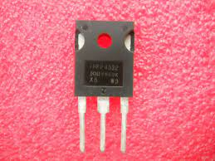
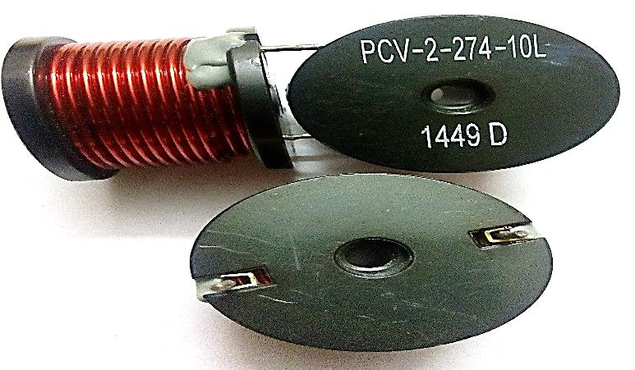
Hardware components
MUR1660 Output Diode
MUR1545
IRFP4332PBF - MOSFET
PCV-2-274-10 - 274uH

Slide 15
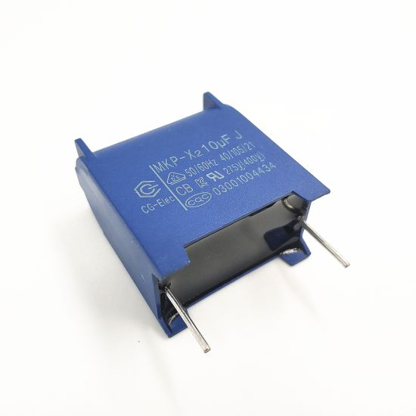
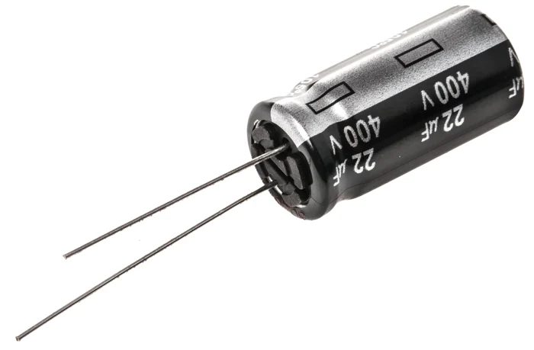
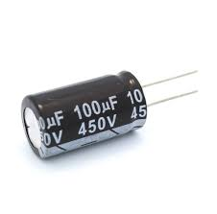
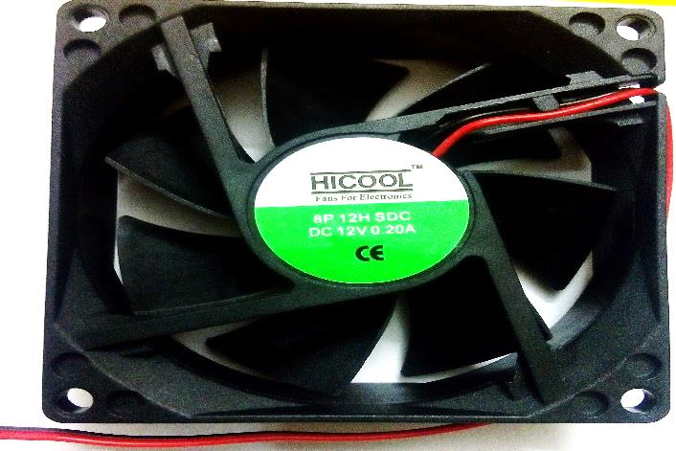
Capacitor - 10uF, 400V
Capacitor - 22uF, 400V
Capacitor - 100uF, 450V
Cooling Fan

Slide 16
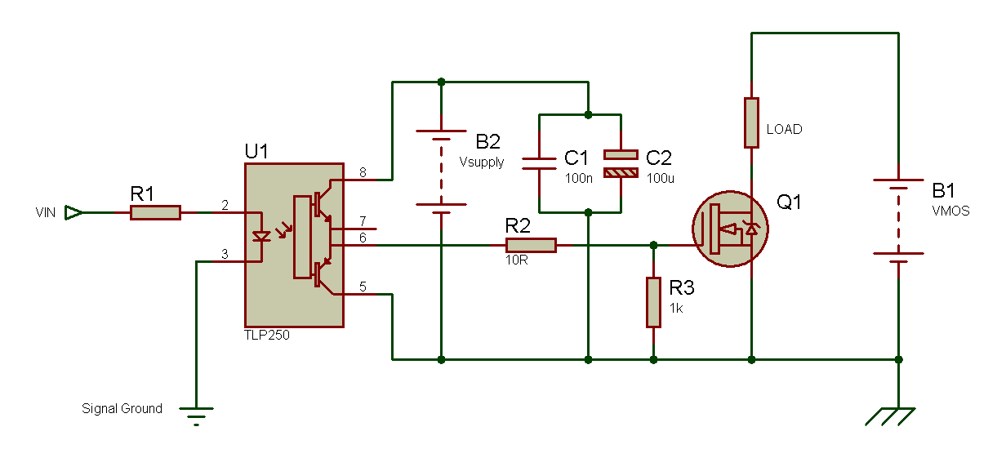
Driver circuit
TLP250 is an opto-coupler which amplifies the voltage from controller. It also provides optical isolation between controller and power circuit.

Slide 17
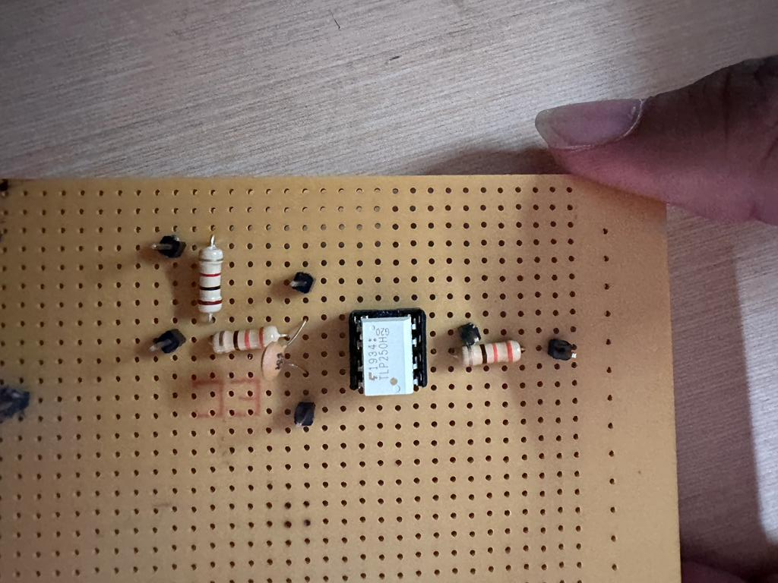
MOSFET Driver Circuit
Resistor 1k ohm
DC Voltage -ve
Ground Pin (3)
Source Pin
Gate pin
Input Voltage Vin (2)
Resistor 220 ohm
Resistor 220 ohm
DC Voltage +ve
IC Circuit TLP250
Capacitor 100uF

Slide 18
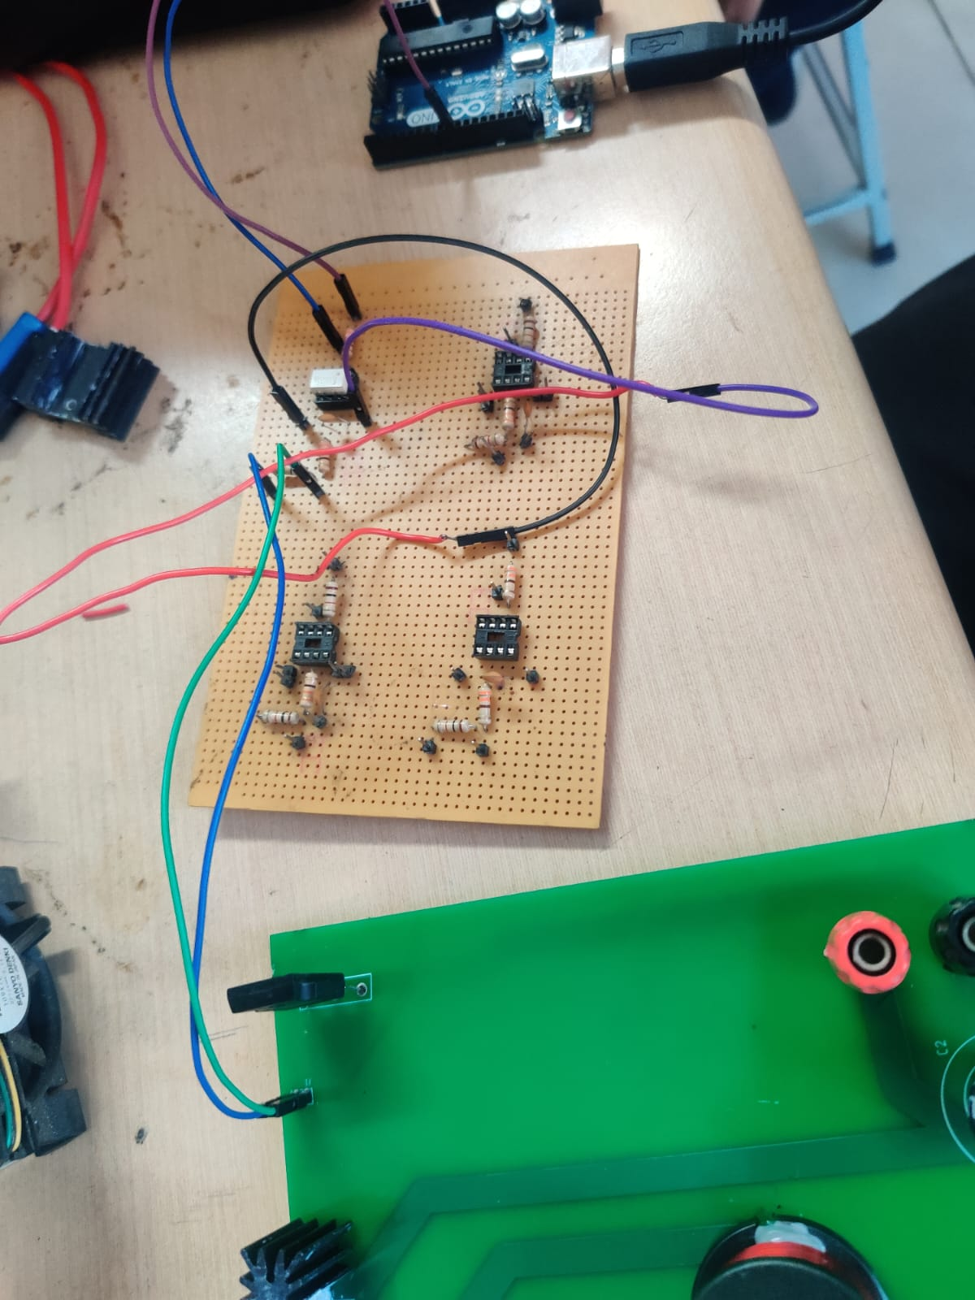
Driver Circuit Connection

Slide 19
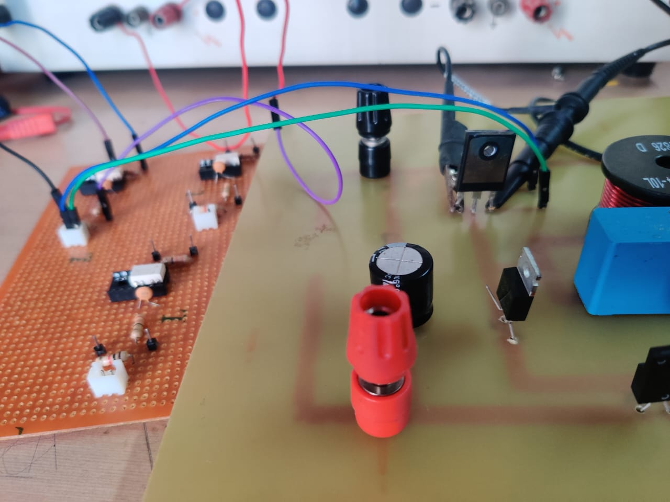
PCB Testing
Connection of Driver circuit to PCB Layout

Slide 20
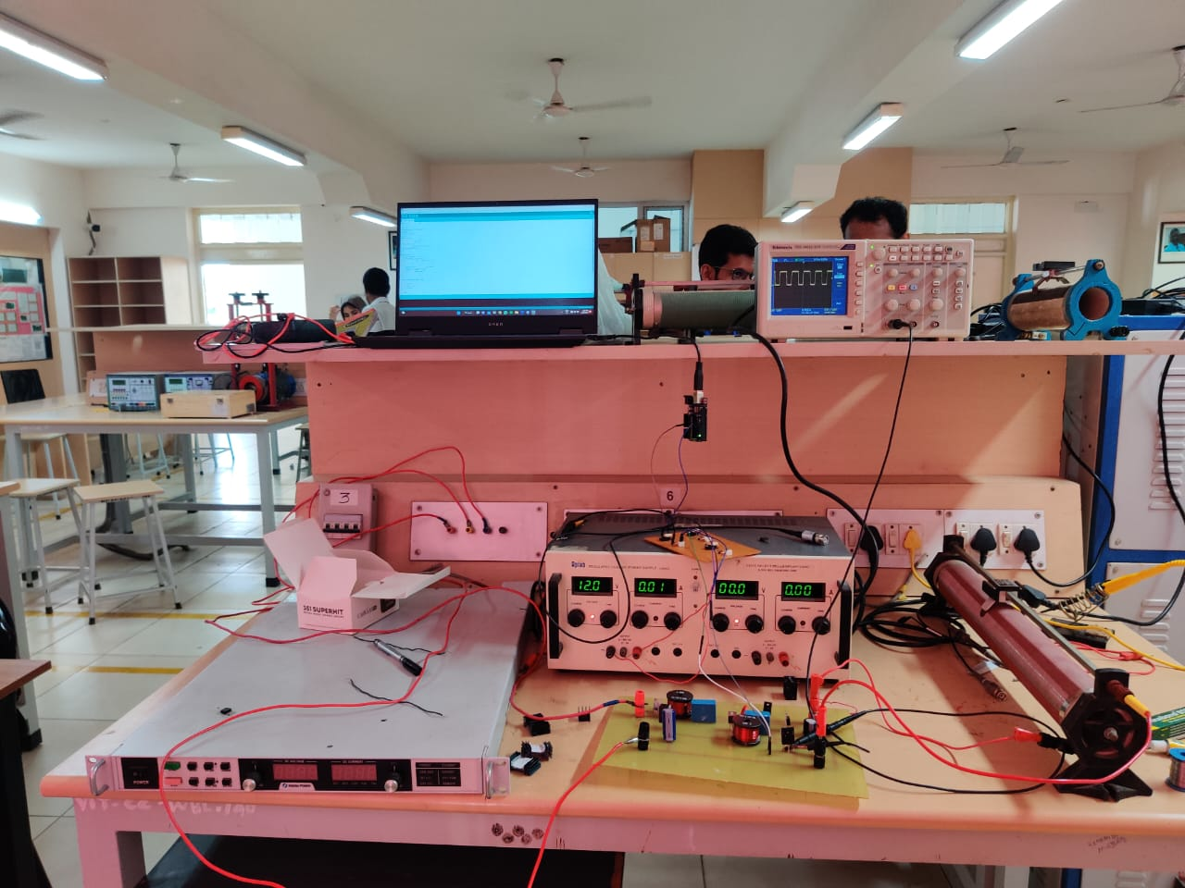
Power DSO
Arduino UNO
DC Power Supply
Driver Circuit
Programmable Power Supply
Single Layer PCB
Resistive Load
Single Layer PCB Testing

Slide 21
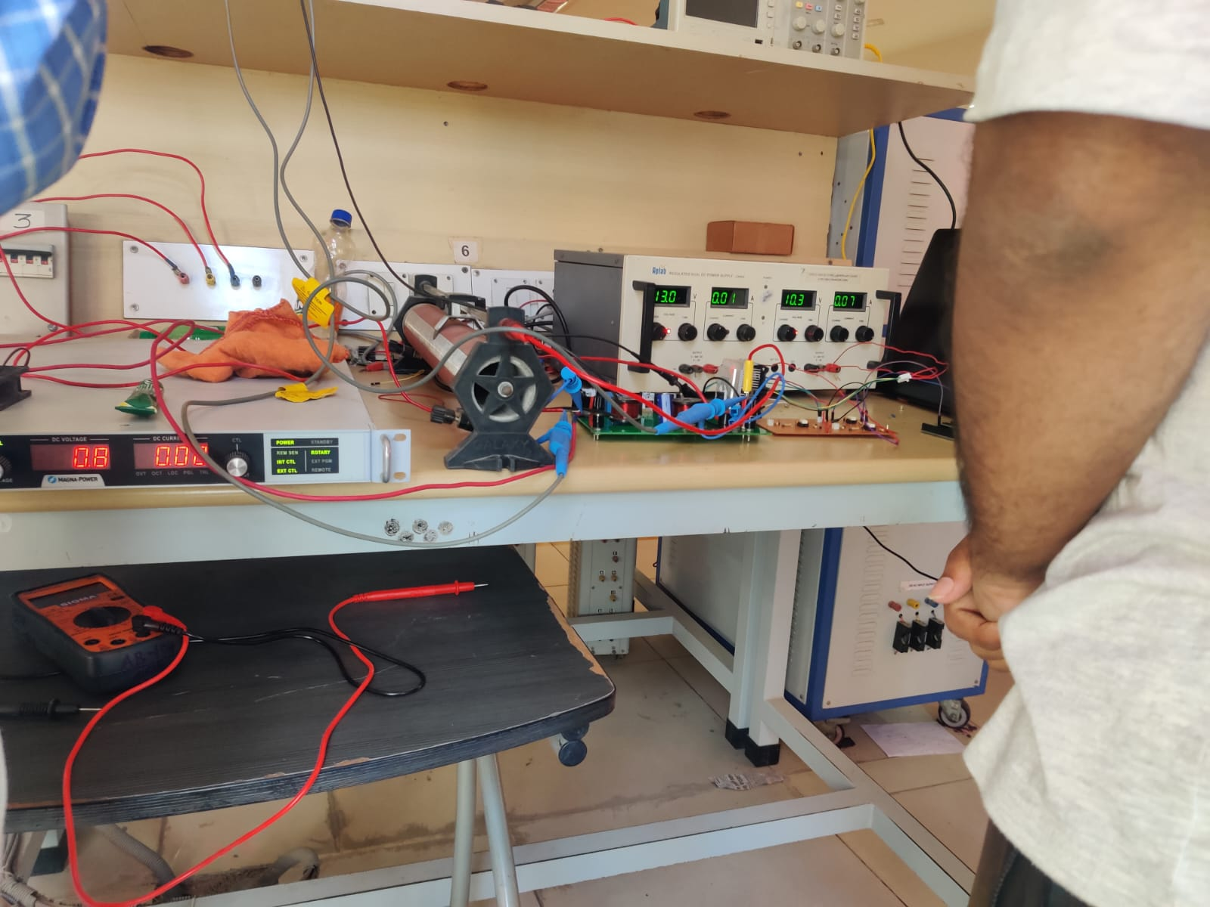
Resistive Load
DC Power Supply
Driver Circuit
Double Layer PCB
Double Layer Pcb Testing
Programmable Power Supply

Slide 22
Hardware Expectations
Theoretical Assumption | Hardware Output
Input Voltage = 35V | Input Voltage = 30.8V
Input Current = 200/35 = 5.714A | Input Current = 7.78A
Input Power = 200W | Input Power = 239.624W
Output Voltage = 385V | Output Voltage = 384V
Output Current = 200/385 = 0.519A | Output Current = 0.594A
Output Power = 200W | Output Power = 228.096W
Efficiency = 200/200 = 100% | Efficiency = 228.096/239.642 = 95.1819%
Resistive Load = (V^2/Po) = 385*385/200 = 741.125 ohms

Slide 23
Source Code
#include <TimerOne.h>
int PWM = 9;
unsigned long timeelapsed;
double out;
double initpwm;
int set = 20;
void setup() {
Timer1.initialize(20);
Serial.begin(9600);
initpwm=0.59;
Timer1.pwm(PWM,(initpwm)*1023);
out=(initpwm*1023);
}
void loop() {
timeelapsed=millis();
if(timeelapsed<10000){
Timer1.pwm(PWM, (initpwm*1023));
}
else{
double inp=(analogRead(A2)/28.6);
double pw=compute(inp);
Timer1.pwm(PWM, pw);
}
}
double compute(double inp)
{
if(inp>set){
if(out>307){
out-=10;
}
else{
out=307;
}
}
else if(inp<set){
if(out<614){
out+=10;
}
else{
out=614;
}
}
return out;
}

Slide 24
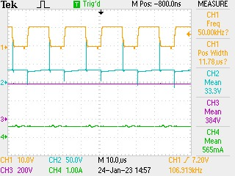
Hardware Output
Channel 1:- Frequency from Mosfet gate source
Channel 2:-
Input Voltage
Channel 3:-
Output Voltage
Channel 4:-
Output Current

Slide 25
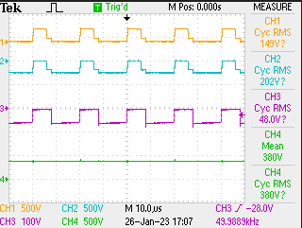
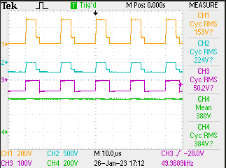
MOSFET and TLP250 Driver circuit PWM pulses
Channel 1:-Voltage Stress
Channel 2 :-V Output Diode
Channel 3:- V Intermediate Diode
Channel 4:- V Output

Slide 26
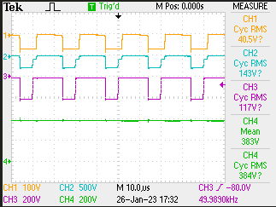
Channel 1:-
V DC1
Channel 2:-
V DC2
Channel 3:-
VDE before switch
Channel 4:-
V Output

Slide 27
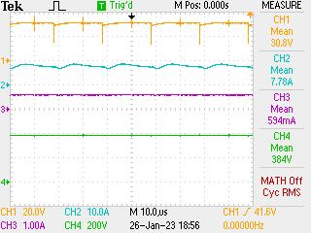
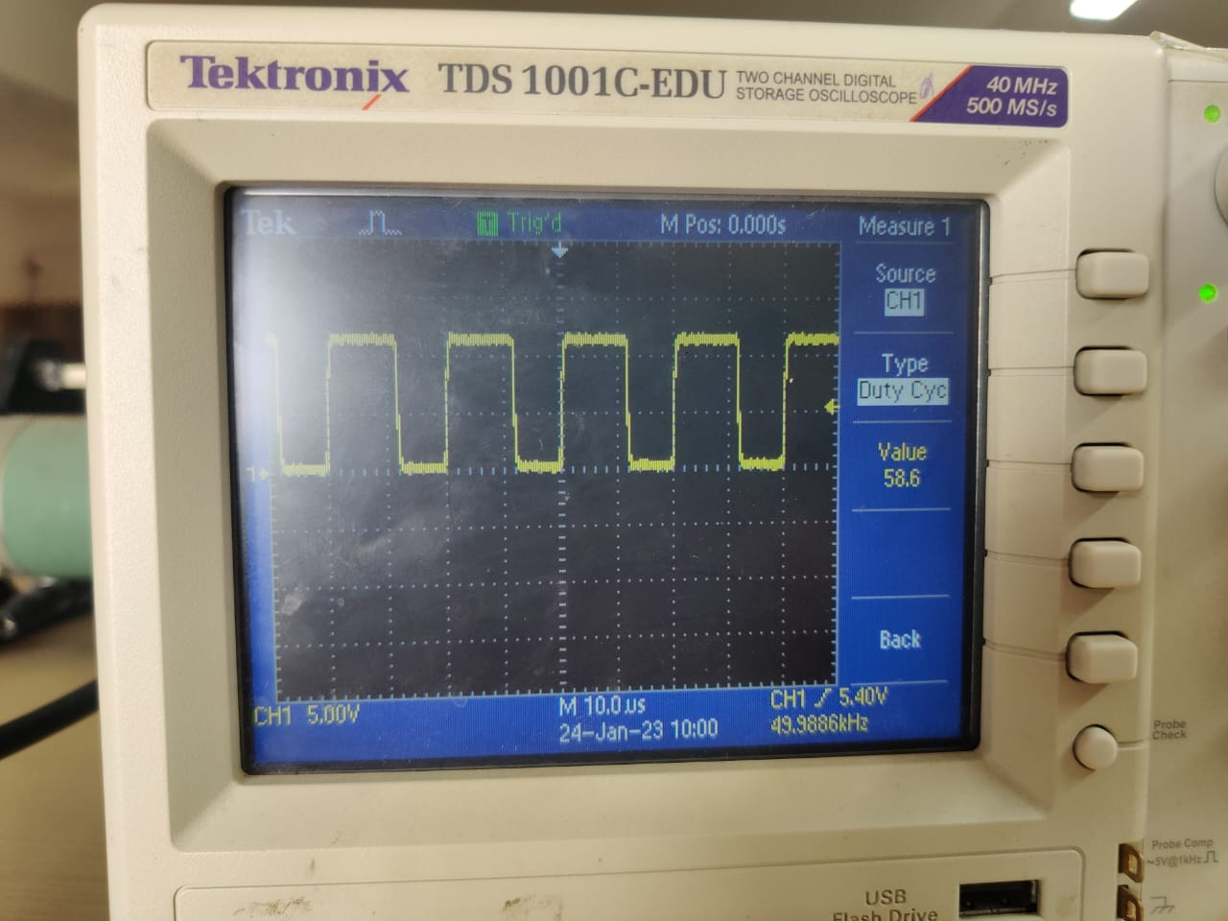
Open Loop Output at 59% Duty Ratio
Channel 1:- Input voltage
Channel 2:- Input Current
Channel 3:- Output Current
Channel 4:- Output Voltage
Duty Cycle Set to 59%

Slide 28
IoT for Data Visualization
We are implementing IoT to visualize the live data obtained from our boost converter from a remote location through connecting it to the internet and displaying the data in a web based application (Streamlit) via an API (Application Programming Interface) called Thingspeak.

Slide 29
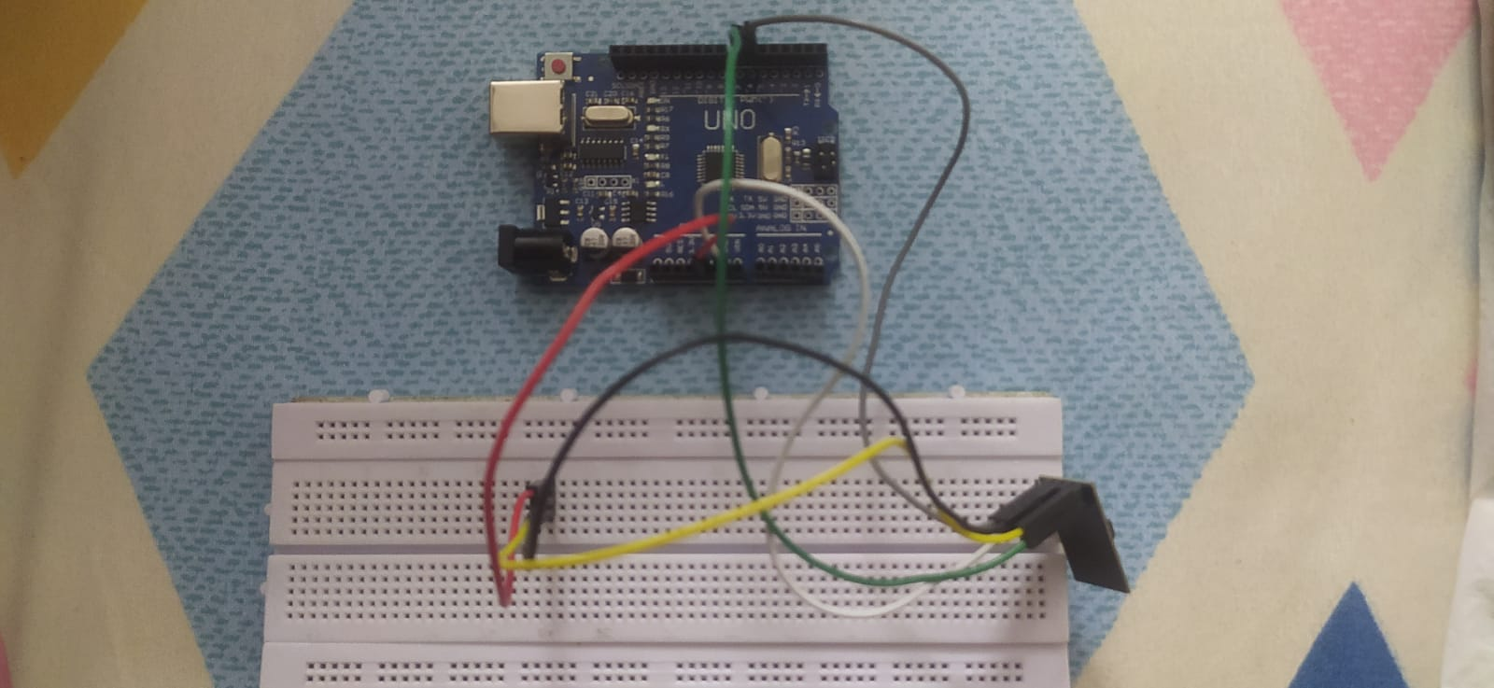
Hardware to Internet
We are using another set of arduino along with ESP8266-01 wifi module to transfer the data to Thingspeak.

Slide 30
Arduino Code for Transferring Data
// initialize serial for ESP module
setEspBaudRate(ESP_BAUDRATE);
while (!Serial) {
; // wait for serial port to connect. Needed for Leonardo native USB port only
}
Serial.print("Searching for ESP8266...");
// initialize ESP module
WiFi.init(&Serial1);
// check for the presence of the shield
if (WiFi.status() == WL_NO_SHIELD) {
Serial.println("WiFi shield not present");
// don't continue
while (true);
}
Serial.println("found it!");
ThingSpeak.begin(client); // Initialize ThingSpeak
}
void loop() {
// Connect or reconnect to WiFi
if(WiFi.status() != WL_CONNECTED){
Serial.print("Attempting to connect to SSID: ");
Serial.println(SECRET_SSID);
while(WiFi.status() != WL_CONNECTED){
WiFi.begin(ssid, pass); // Connect to WPA/WPA2 network. Change this line if using open or WEP network
Serial.print(".");
delay(5000);
}
#include "WiFiEsp.h"
#include "secrets.h"
#include "ThingSpeak.h" // always include thingspeak header file after other header files and custom macros
char ssid[] = SECRET_SSID; // your network SSID (name)
char pass[] = SECRET_PASS; // your network password
int keyIndex = 0; // your network key Index number (needed only for WEP)
WiFiEspClient client;
// Emulate Serial1 on pins 6/7 if not present
#ifndef HAVE_HWSERIAL1
#include "SoftwareSerial.h"
SoftwareSerial Serial1(6, 7); // RX, TX
#define ESP_BAUDRATE 19200
#else
#define ESP_BAUDRATE 115200
#endif
unsigned long myChannelNumber = SECRET_CH_ID;
const char * myWriteAPIKey = SECRET_WRITE_APIKEY;
void setup() {
//Initialize serial and wait for port to open
Serial.begin(115200); // Initialize serial
while(!Serial){
; // wait for serial port to connect. Needed for Leonardo native USB port only
}

Slide 31
Serial.println("\nConnected.");
}
double voltage = analogRead(A2);
double current = voltage/722;
double power = voltage*current;
// set the fields with the values
ThingSpeak.setField(1, voltage);
ThingSpeak.setField(2, current);
ThingSpeak.setField(3, power);
int x = ThingSpeak.writeFields(myChannelNumber, myWriteAPIKey);
if(x == 200){
Serial.println("Channel update successful.");
}
else{
Serial.println("Problem updating channel. HTTP error code " + String(x));
}
delay(20000); // Wait 20 seconds to update the channel again
}
// This function attempts to set the ESP8266 baudrate. Boards with additional hardware serial ports
// can use 115200, otherwise software serial is limited to 19200.
void setEspBaudRate(unsigned long baudrate){
long rates[6] = {115200,74880,57600,38400,19200,9600};
Serial.print("Setting ESP8266 baudrate to ");
Serial.print(baudrate);
Serial.println("...");
for(int i = 0; i < 6; i++){
Serial1.begin(rates[i]);
delay(100);
Serial1.print("AT+UART_DEF=");
Serial1.print(baudrate);
Serial1.print(",8,1,0,0\r\n");
delay(100);
}
Serial1.begin(baudrate);
}
// This file is for storing all of the private credentials
// and connection details
#define SECRET_SSID "Mclerry" // replace MySSID with your WiFi network name
#define SECRET_PASS "chirupaul" // replace MyPassword with your WiFi password
#define SECRET_CH_ID 1995845 // replace 0000000 with your channel number
#define SECRET_WRITE_APIKEY "EACF7SNEBLBLPTBC" // replace XYZ with your channel write API Key

Slide 32
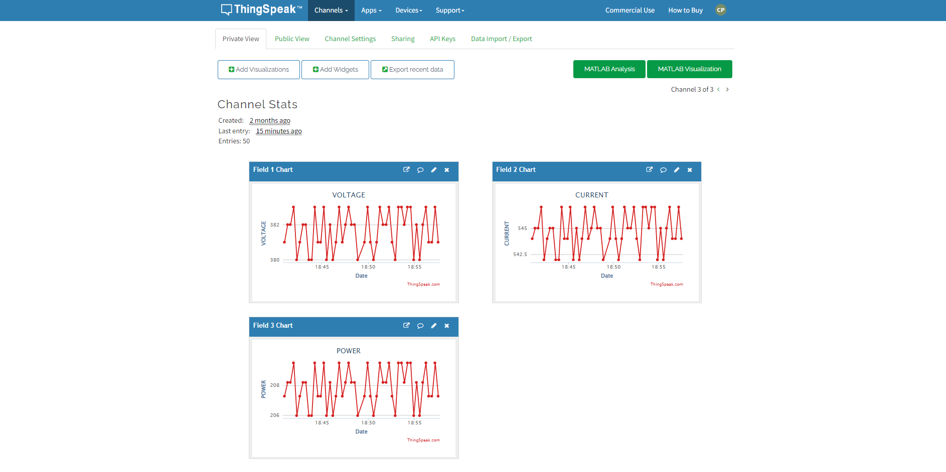
Thingspeak API
The data from arduino is stored in Thingspeak and can be accessed by Streamlit through JSON which helps in updating the data spontaneously.

Slide 33
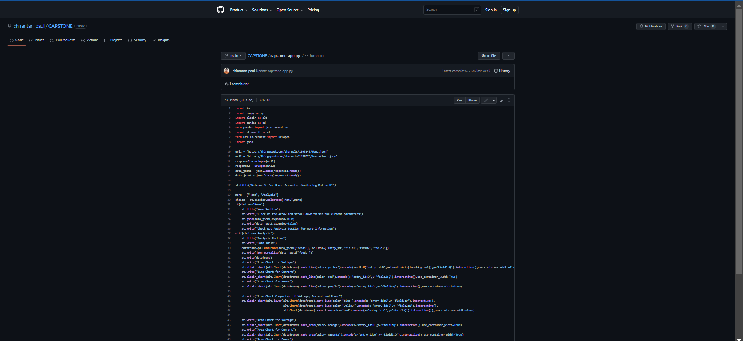
Streamlit Web App

Slide 34
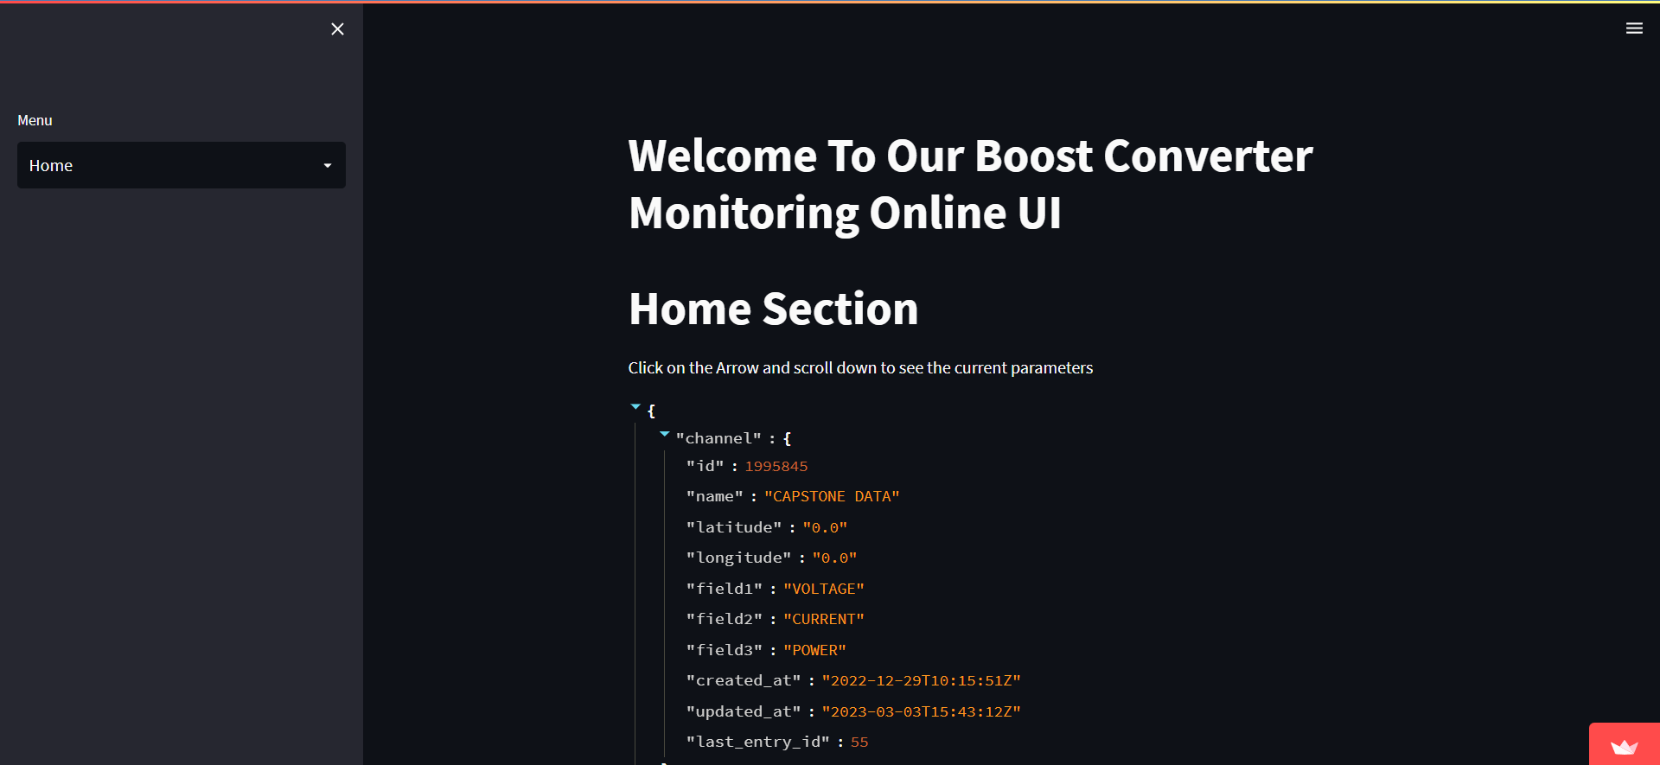
Home Section

Slide 35
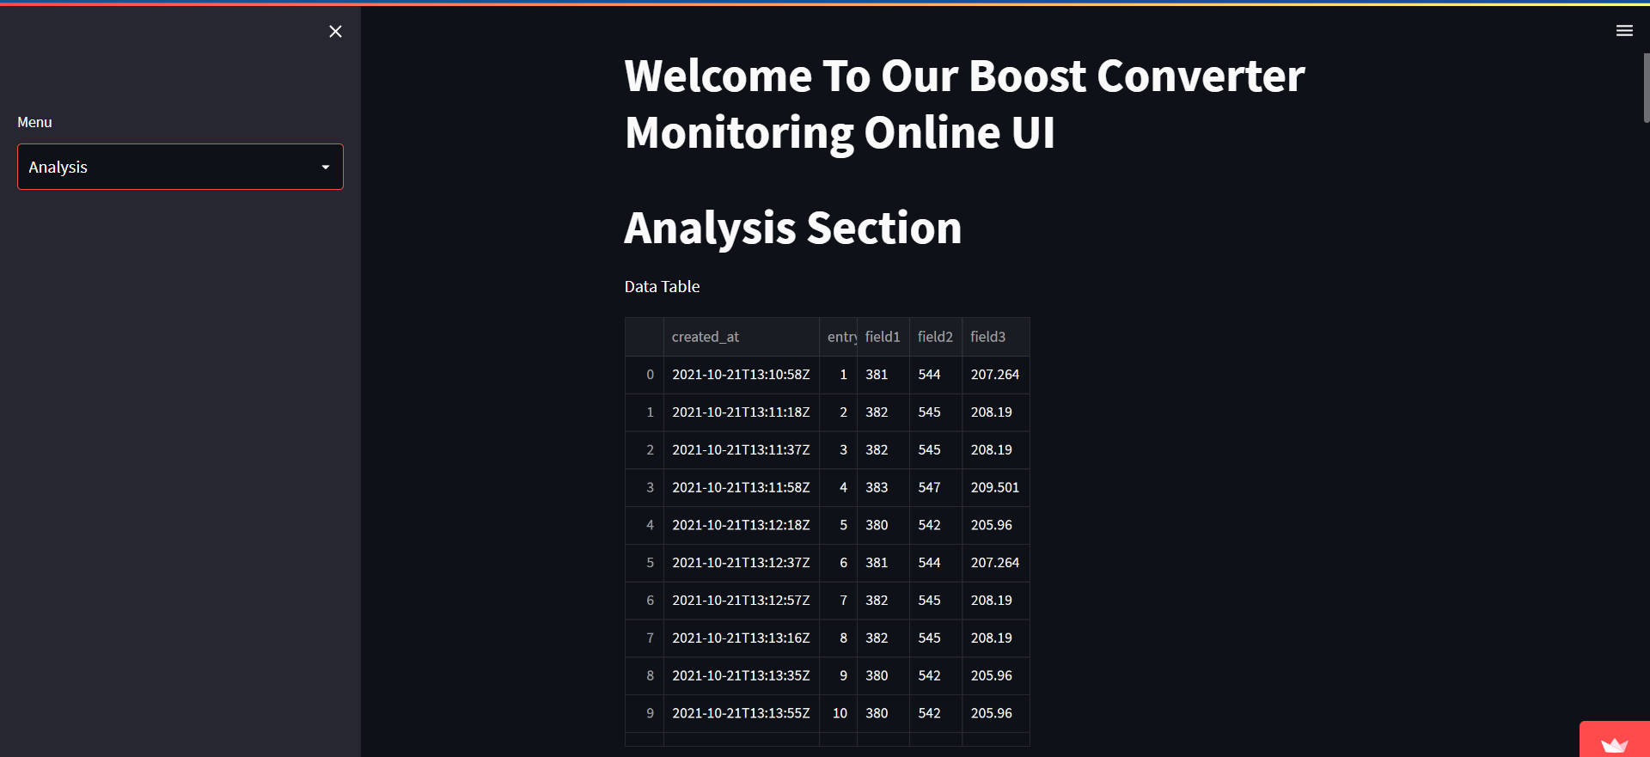
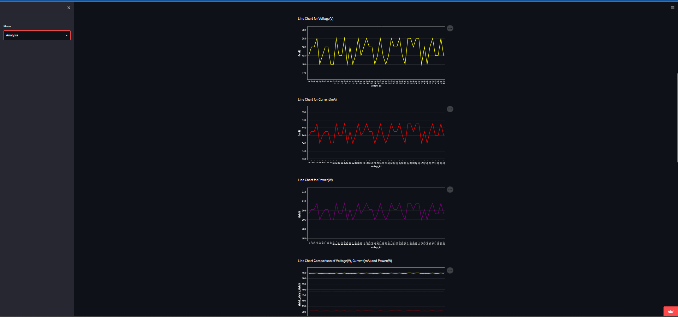
Analysis Section

Slide 36
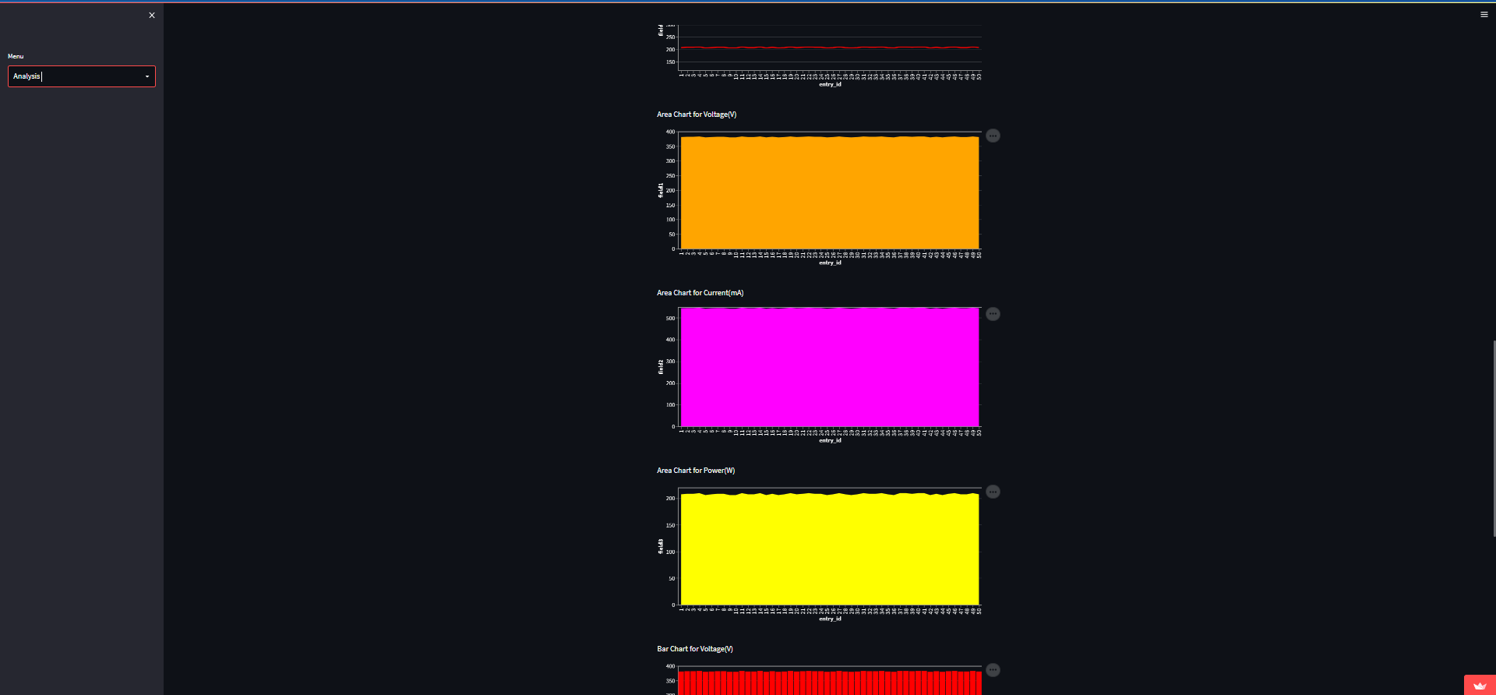
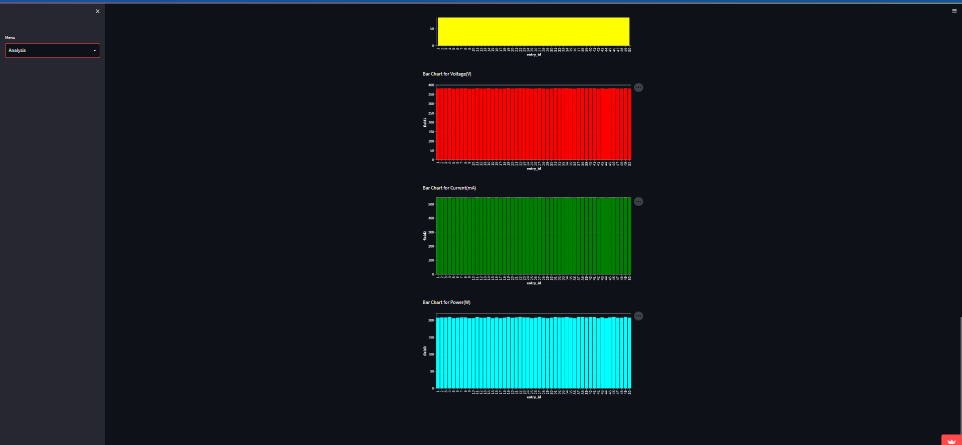

Slide 37
Work Plan
Modules/ Reviews | Nov | Dec | Jan | Feb | March
Module -1 (Design and Simulation)
Module -2 (Hardware Implementation)
Module -3 (Testing)
Documentation

Slide 38
References
Non-Isolated DC-DC Converter with High Voltage Gain for DC Grid
Kapuluru Shravya , Nilanjan Tewari , Meenakshi J and Sreedevi V T Vellore Institute of Technology, Chennai Campus, Tamil Nadu, India, 600127
https://en.wikipedia.org/wiki/DC-to-DC_converter
M. Feng, K. Qu, J. Zhao and M. Sun, "Non-isolated DC-DC converter with high voltage gain," 2016 IEEE Innovative Smart Grid Technologies - Asia (ISGT-Asia), 2016, pp. 730-734, doi: 10.1109/ISGT-Asia.2016.7796475.
https://archive.nptel.ac.in/courses/108/108/108108036/
https://www.teachmemicro.com/arduino-pid-control-tutorial/
https://www.youtube.com/watch?v=aSO43xxQ9U
https://www.youtube.com/watch?v=6MxLSAUsGVc
https://chirantan-paul-capstone-capstone-app-snzdwx.streamlit.app/
https://github.com/chirantan-paul/CAPSTONE

Slide 39
Thank You

